Slide 1






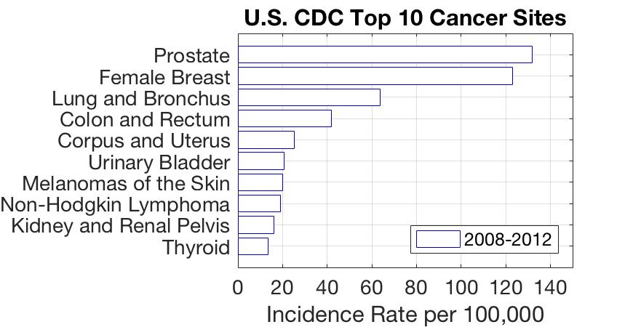
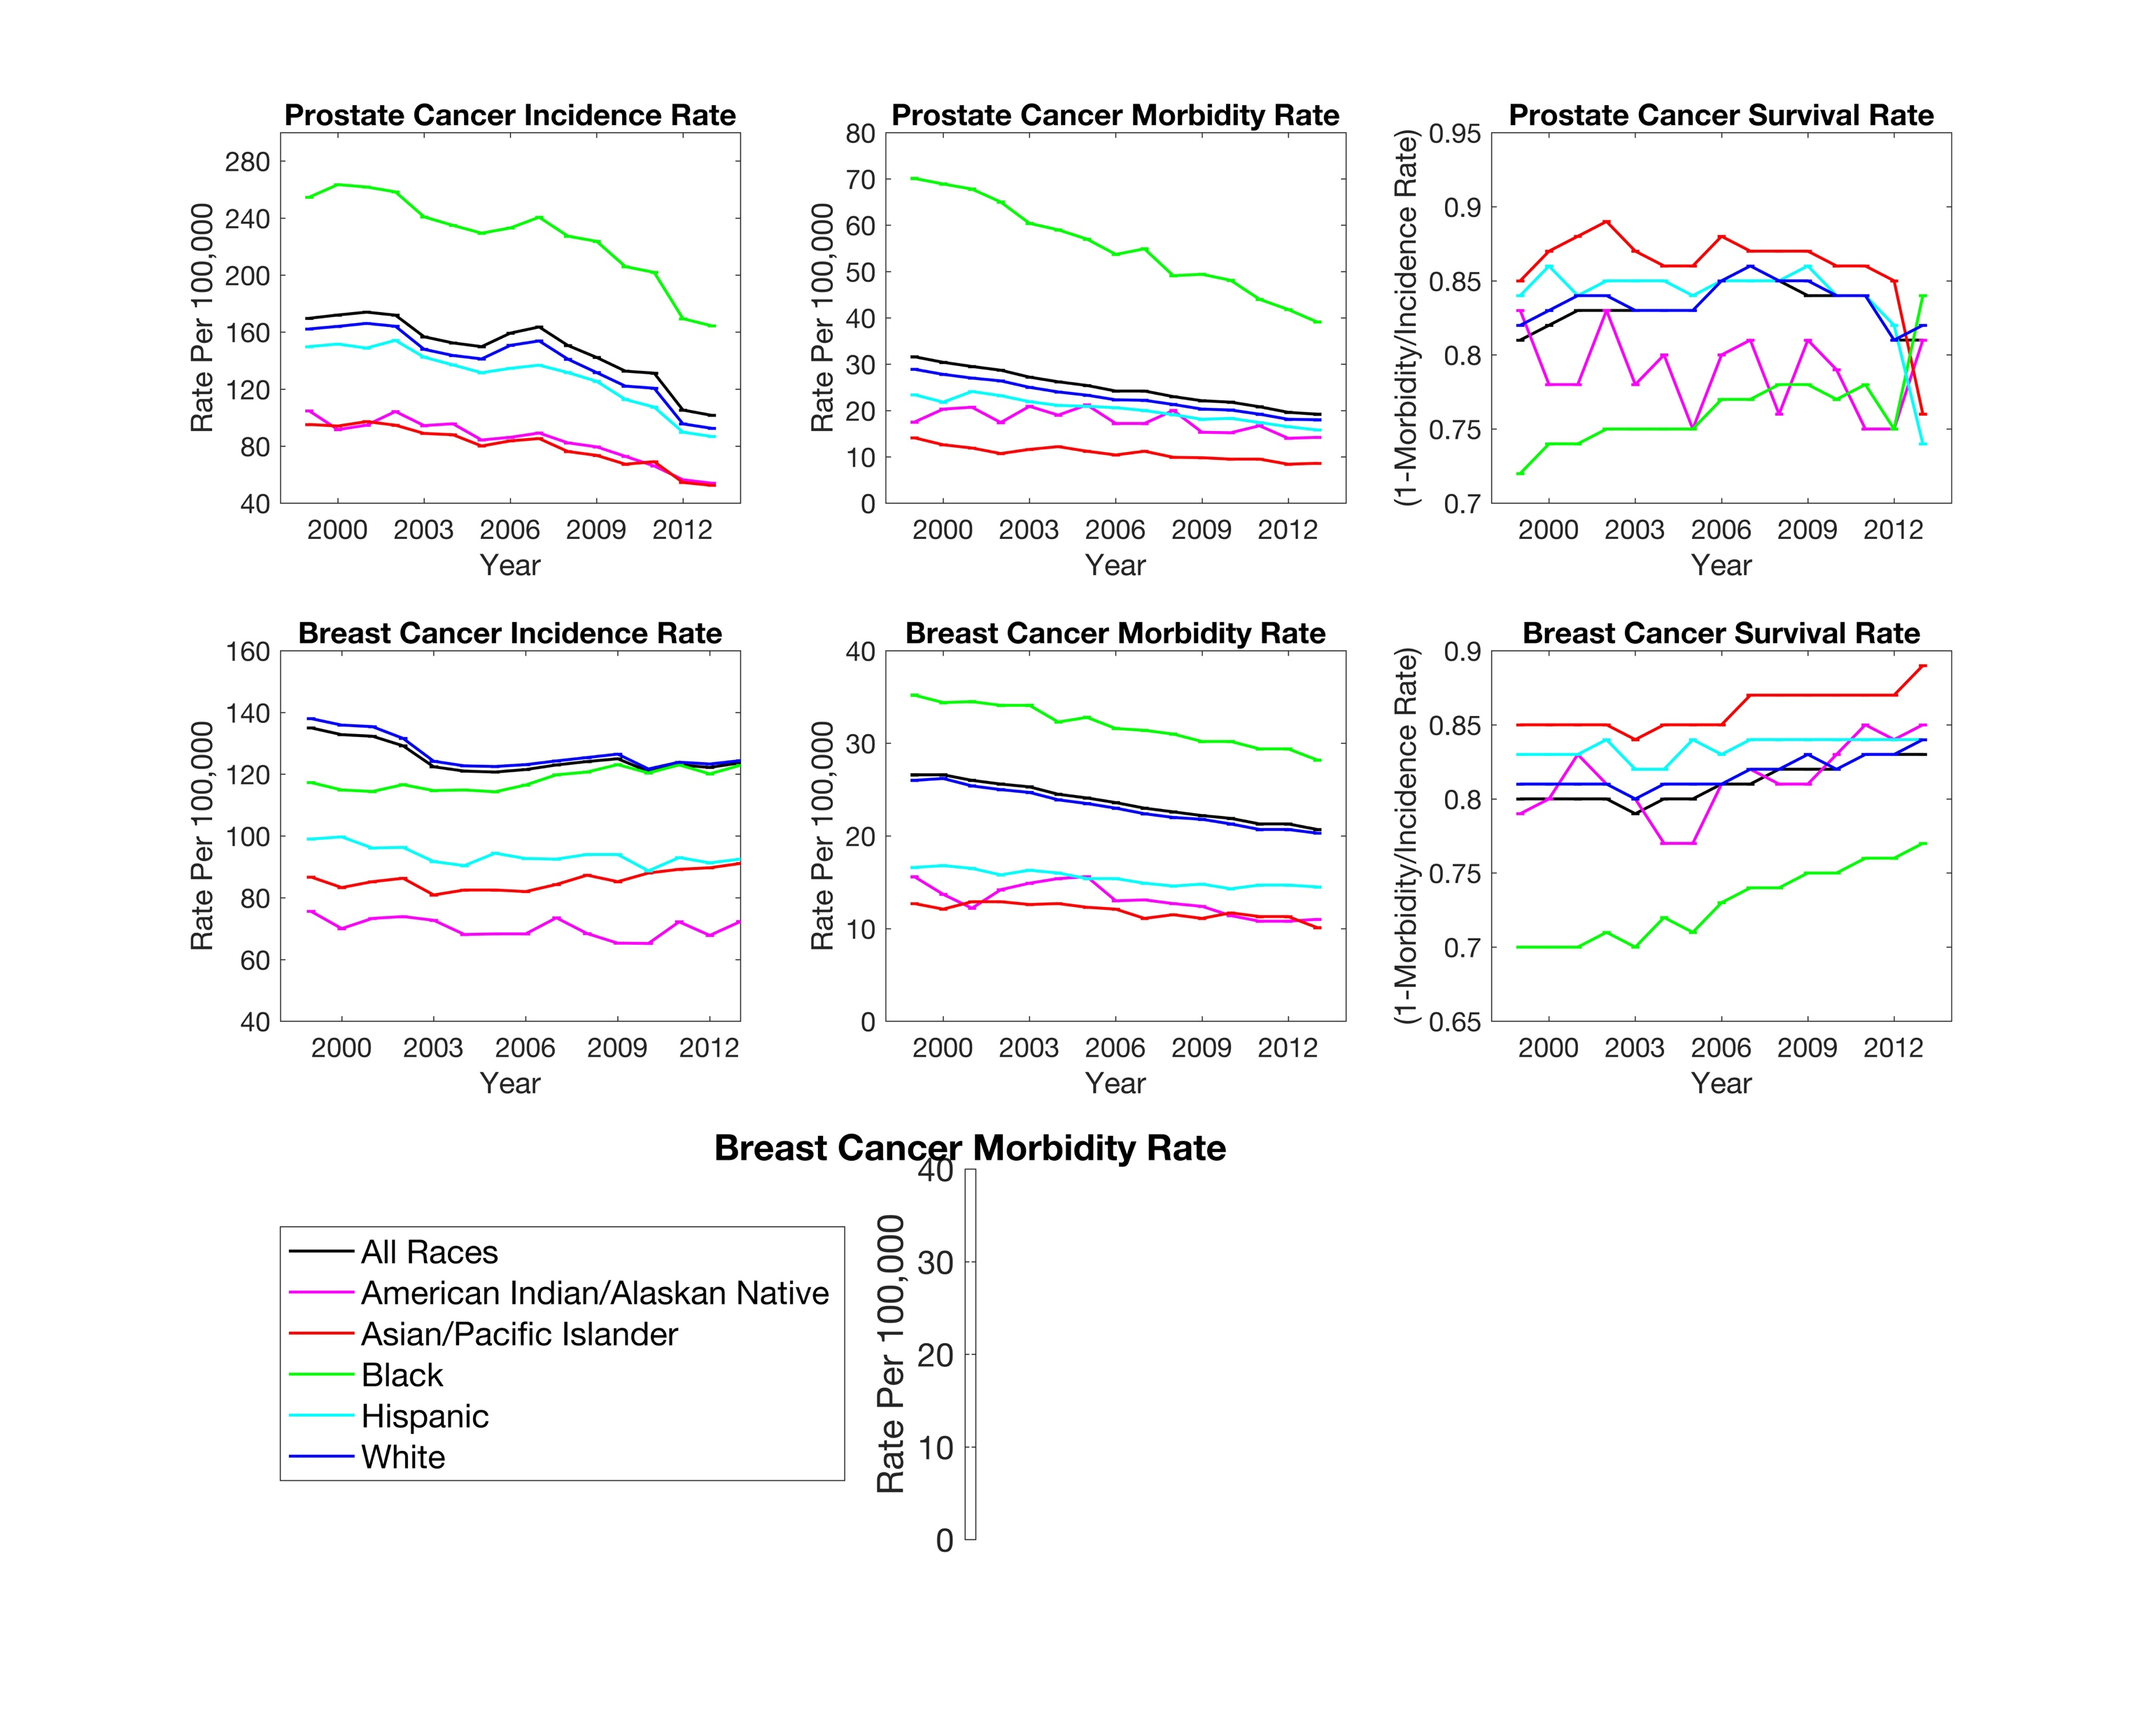
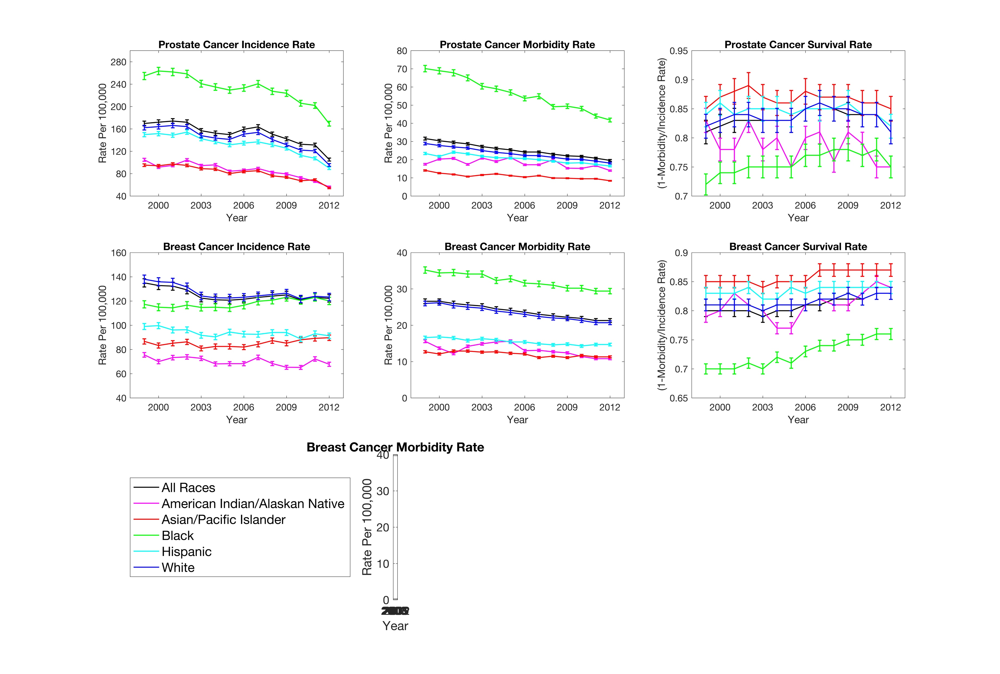
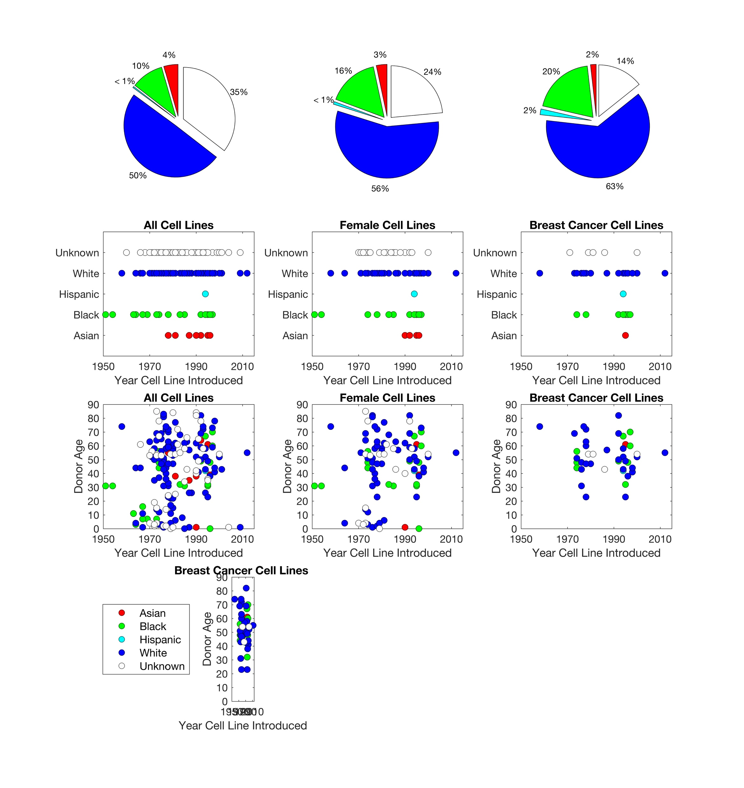
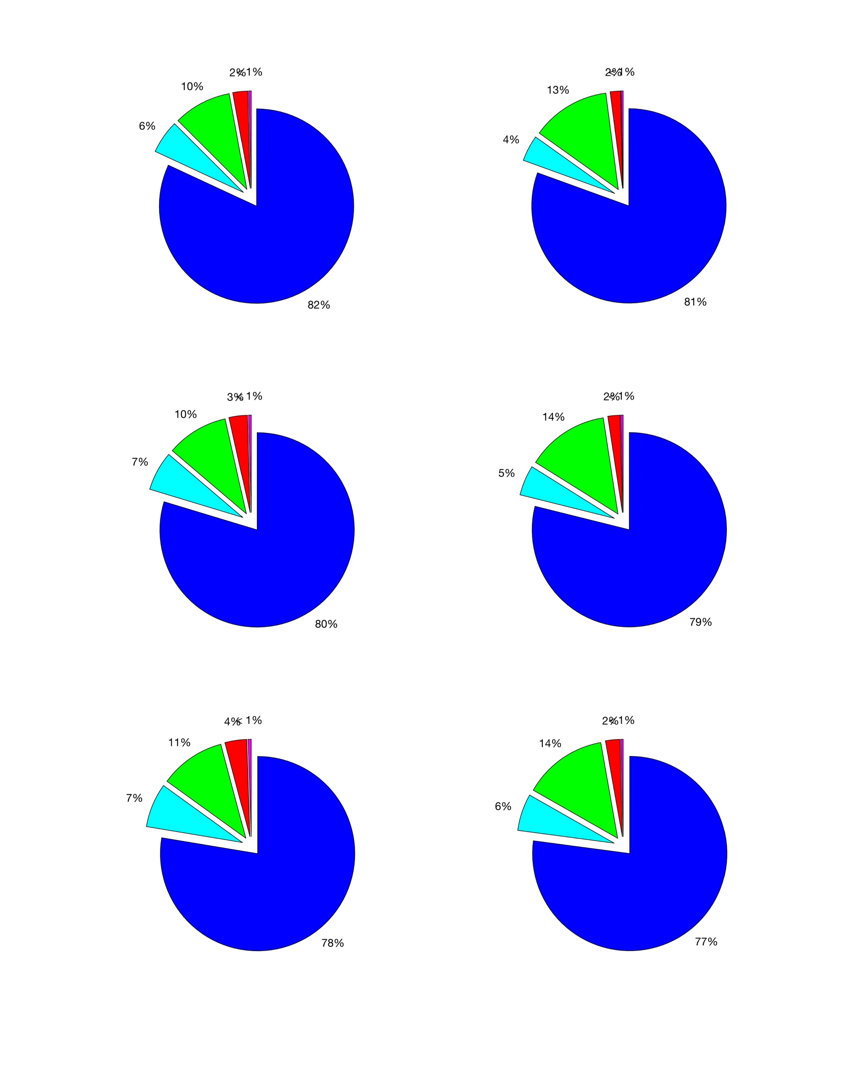
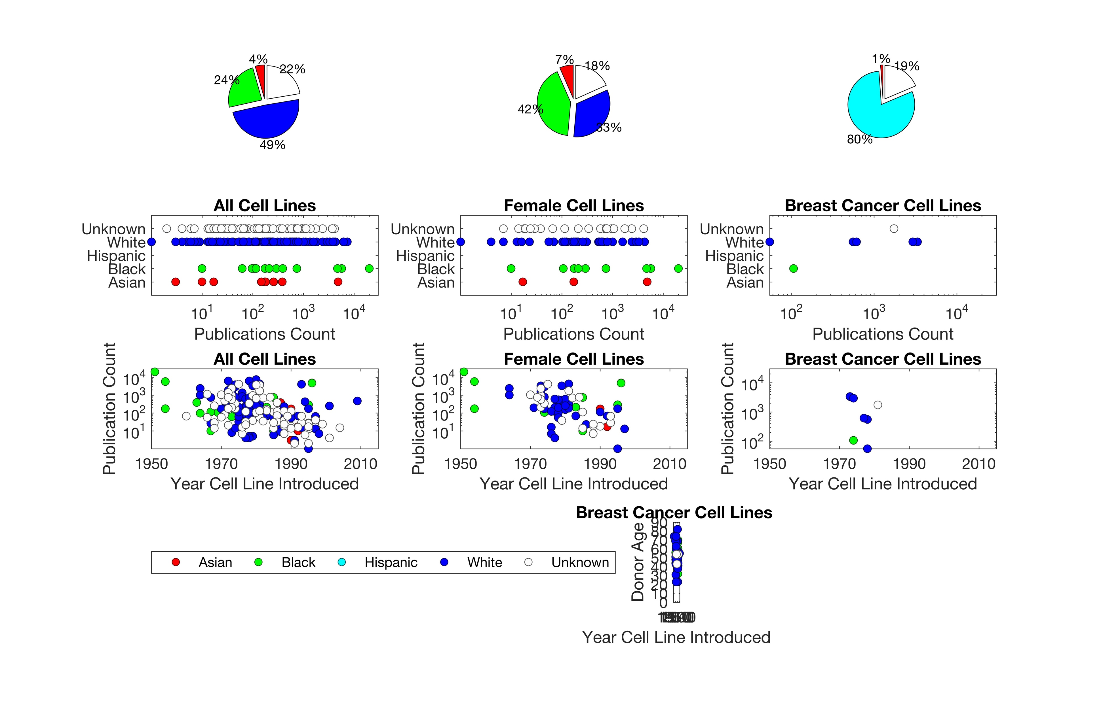
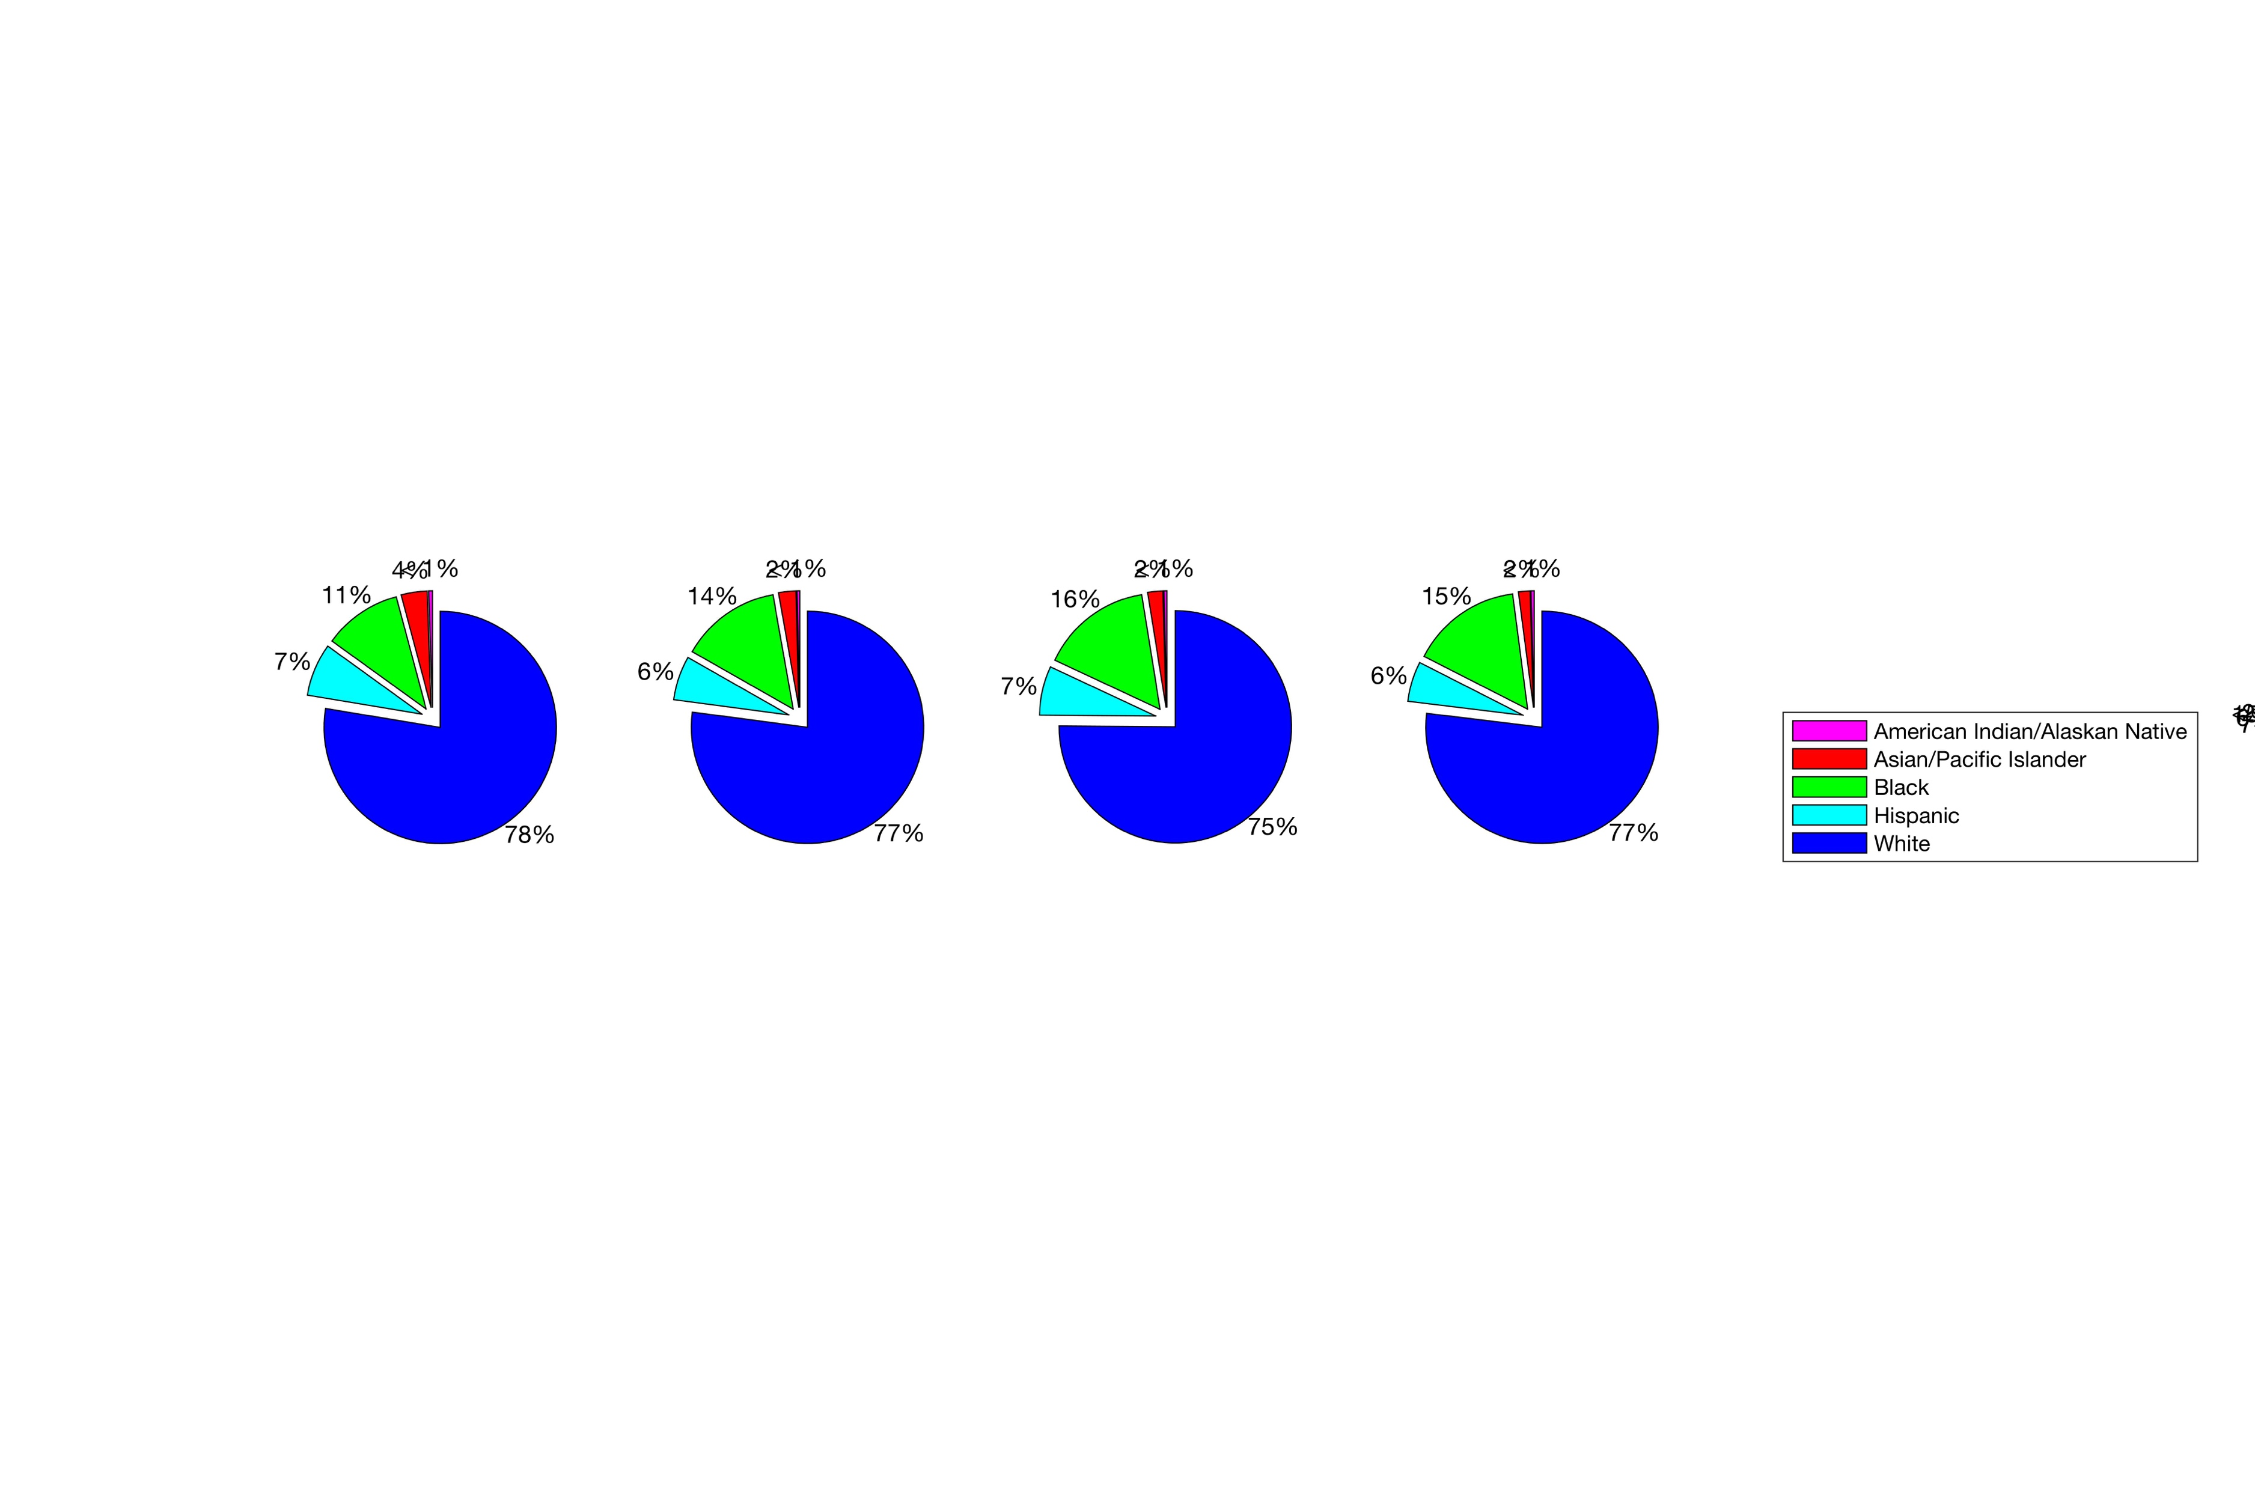
Demographic Inclusiveness in Human Cell Studies
Iva Bojic^{1,2}
Aaron Gerow³
Jessica Snyder^{1,2}
Carlo Ratti^{1,2} (ratti@mit.edu)
SENSEable City Lab, Department of Urban Studies and Planning, Massachusetts Institute of Technology
SENSEable City Lab, Future Urban Mobility Interdisciplinary Research Group, Singapore-MIT Alliance for Research and Technology
Computation Institute, University of Chicago
RATIONALE: WHAT IS THE DEMOGRAPHIC REPRESENTATION DURING MEDICAL RESEARCH? COULD REPRESENTATION EFFECT THE EFFICACY OF TREATMENT?
STEP 1. DISCOVERY AND DEVELOPMENT
STEP 2. PRECLINICAL RESEARCH
STEP 3. CLINICAL RESEARCH
STEP 4.
FDA REVIEW
DRUG DEVELOPMENT PROCESS
HUMAN CELL MODEL
ANIMAL MODEL
STEP 5.
POST-MARKETING
SAFETY MONITORING
Step 2 to become increasingly significant with advances in tissue engineering
STEP 2 USES HUMAN CELLS.
SHOULD DEMOGRAPHICS BE CONSIDERED?
STEP 3 USES HUMAN SUBJECTS, FDA REQUIRES INCLUSIVE DEMOGRAPHIC REPRESENTATION
Q1. WHERE IS A CURRENT CHALLENGE IN MEDICINE?
Q2. WHEN PATIENTS ARE GROUPED BY DEMOGRAPHICS, IS THERE A DISPERITY IN THE EFFICACY OF TREATMENT?
A1. U.S CENTER FOR DISEASE CONTROL (CDC) STATISTICS
A2. MORBIDITY RATE IS HIGHER, SURVIVAL RATE IS LOWER FOR BLACK BREAST CANCER PATIENTS.
CASE STUDY WITH BREAST CANCER
Future work
HOW TO CORRECT
Starting point
PRIMARY CELLS
Q3. WHAT TOOLS ARE AVAILABLE TO
STUDY INTRINSIC FACTORS?
INTRINSIC FACTORS
EXTRINSIC FACTORS
SIGNIFICANT, YET OUTSIDE THE SCOPE OF THIS WORK
HUMAN CELL LINES
Q4. HOW ARE THE CELL LINES USED BY THE RESEARCH COMMUNITY?
Q5. HOW DOES PUBLICATION RECORD COMPARE TO DEMOGRAPHICS OF THE PATIENT POPULATION?
A3. COMMERCIALLY AVIALBLE CELL LINES INCLUDE ASIAN, BLACK, HISPANIC, WHITE, AND UNSPECIFIED DONOR ETHNICITIES.
A4. CHARACTERIZATION OF DEMOGRAPHIC INCLUSIVENESS IN MEDLINE AND SCOPUS PUBLICATIONS.
A5. THE DEMOGRAPHIC REPRESENTATION OF THE PATIENT POPULATION IS NOT CONSISTENT WITH PUBLICATION RECORD.
All Cell Lines
(247 Donors)
Female Cell Lines
(118 Donors)
Breast Cancer Cell Lines
(55 Donors)
All Cell Lines
(136,374 Publications)
Female Cell Lines
(76,314 Publications)
Breast Cancer Cell Lines
(9,349Publications)
2003 Breast Cancer
Incidence Count (204,803)
2003 Breast Cancer
Death Count (43,503))
2008 Breast Cancer
Incidence Count (227,214)
2008 Breast Cancer
Death Count (42,729)
2013 Breast Cancer
Incidence Count (246,183)
2013 Breast Cancer
Death Count (43,531)
CONCLUSION. THIS RETROSPECTIVE CHARACTERIZES THE EXISTING TOOL KIT FOR MEDICAL RESEARCHERS TO STUDY INTRINSIC FACTORS OF DISEASE, EXPOSING GAPS IN DEMOGRAPHIC REPRESENTATION , ALLOWING FOR DISCUSSION PER DEFICIENCIES IN TREATMENT EFFICACY ON A POPULATION-LEVEL. Acknowledgement. The research is supported by the National Research Foundation, Prime Minister’s Office, Singapore, under its CREATE programme, Singapore-MIT Alliance for Research and Technology (SMART) Future Urban Mobility (FM) IRG. Prepared for Singapore-MIT Alliance for Research and Technology (SMART) Future Urban Mobility Symposium poster presentation on July 25-26, 2016 2016.

